Slide 1
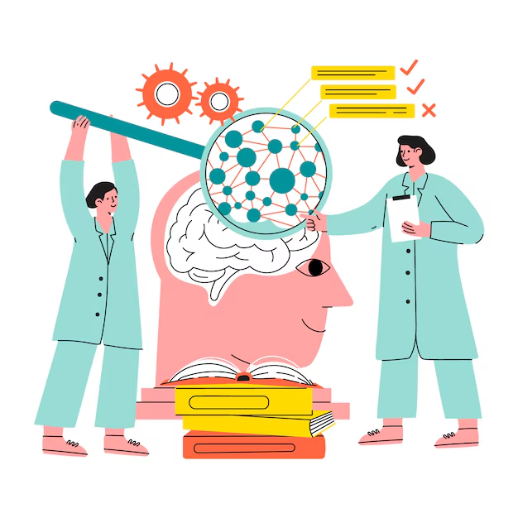
Ontology with Protege
Knowledge-based System Engineering
Intelligent Information Management Lab
Laboratorium Manajemen Cerdas Informasi

Slide 2
What is Protégé?
A free, open-source ontology editor and framework for building intelligent systems
Protégé is supported by a strong community of academic, government, and corporate users, who use Protégé to build knowledge-based solutions in areas as diverse as biomedicine, e-commerce, and organizational modelling
Download: https://protege.stanford.edu/

Slide 3
Class
Specify the same properties from several instances
Support hierarchical classification
Superclass / Subclass
  Subclass is a more specific version of its superclass
  Every subclass inherits the operation and attributes from their superclass
  Subclass can have their own operation and attributes

Slide 4
Class Description
Equivalent classes
  Parent is any Person who has a child.
Superclasses
Members
  Describes an individual who is a member of the referred class.
Disjoint classes
  Members of that class cannot become members of another class.
  Often it is not necessary to define it, unless using external reasoning or other applications that require a more explicit class definition. t
  Example: Father disjoint class with Mother

Slide 5
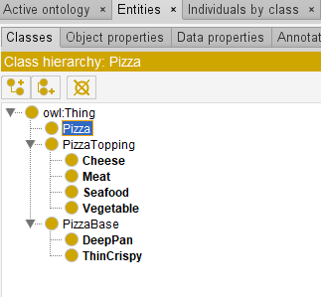
Example
Thing
Pizza
PizzaBase
PizzaTopping
Cheese
Meat
Seafood
Vegetable
ThinCrunchy
DeepPan
...

Slide 6
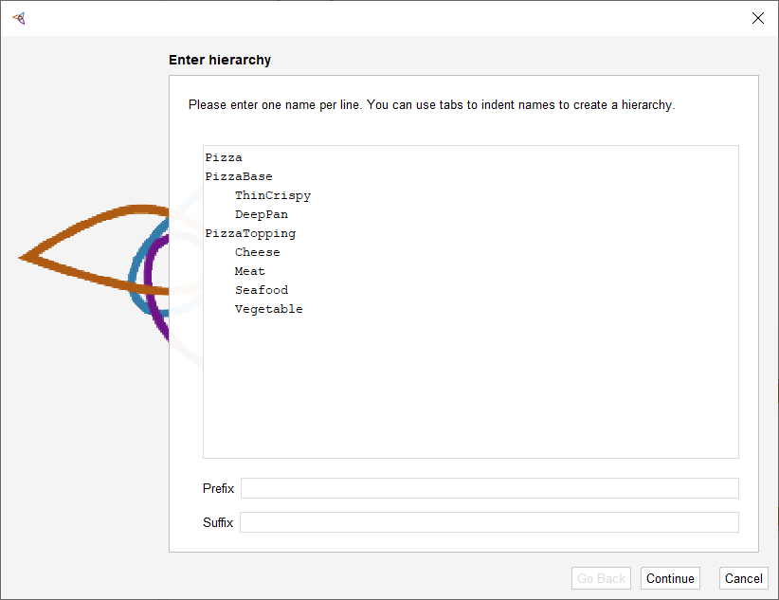
Class Hierarchy

Slide 7
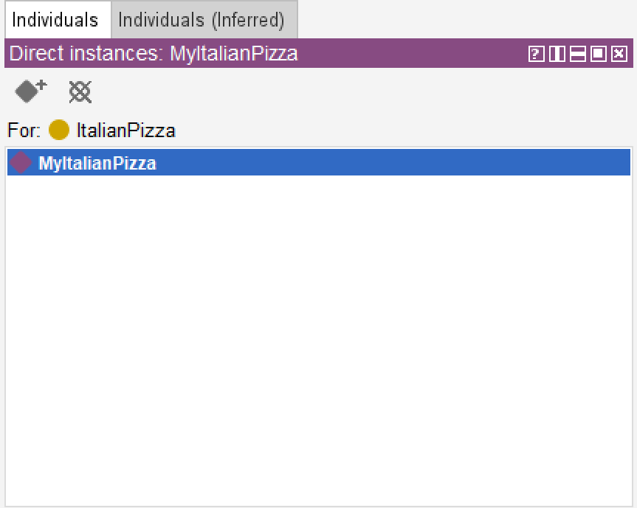
Individual
Refer to identified object in conceptual model
  Tangible (tools, parts, etc)
  Intangible (concept, mental constructions)

Slide 8
Object Property
It is used to show the relationship between one class/individual to another.
Functional
Transitive
Symmetric
Asymmetric
Reflexive
Irreflexive
Inverse functional

Slide 9
Functional property
Shows the relationship between one individual and another.
  There is at least 1 functional property that connects between individuals
hasTopping
ItalianPizza
Mozzarela

Slide 10
Inverse Functional Property
If a functional property connects A to B, then its inverse property will connect B to A.
hasTopping
ItalianPizza
Mozzarela
isToppingOf

Slide 11
Transitive Property
If an individual A is connected to individual B and individual B is connected to individual C, then we can say that A is transitively connected to C via B.
ItalianPizza
hasIngredient
Mozzarela
hasIngredient
Milk
hasIngredient

Slide 12
Symmetric Property
Shows the same/symmetrical relationship from both individuals, A to B and B to A.
hasSibling
Danny
Debby
hasSibling

Slide 13
Reflexive Property
Shows that an individual can connect to himself
knows
Danny
James
knows
knows

Slide 14
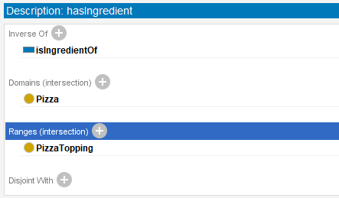
Domain and Range
Object Property connects class/individual from a domain to individuals from a Range.

Slide 15
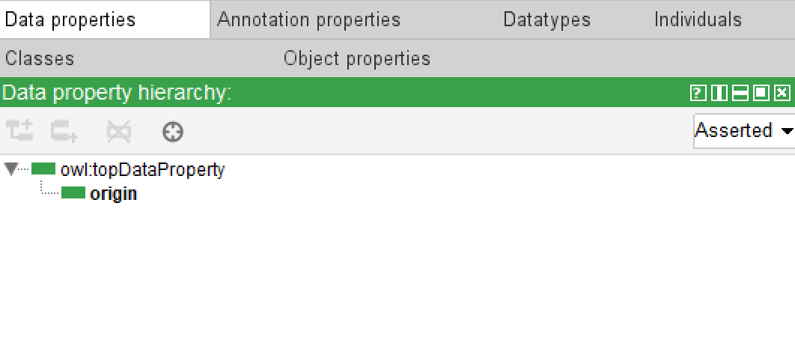
Data Property
Almost the same as the object property, but the range is of type Literal
Example:
  hasFullName connect Person with string
  hasDateofBirth connect Person with date

Slide 16
Description Logic

Slide 17
Why Description Logic?
Every student is a person.
Student ⊑ Person
Easy for human, ambiguous for computer
DL provides a formal foundation for ontology reasoning.

Slide 18
DL Constructors Summary
Constructor | Meaning | Example
⊓ | AND | Student ⊓ Researcher
⊔ | OR | CoreCourse ⊔ ElectiveCourse
¬ | NOT | ¬Student
∃ | Some | ∃ enrolledIn.Course
∀ | Only | ∀ enrolledIn.Course
≥ n | At least | ≥2 teaches.Course
≤ n | At most | ≤5 enrolledIn.Course
= n | Exactly | =1 hasCode.String
⊑ | Subclass | Student ⊑ Person
≡ | Equivalent | A ≡ B

Slide 19

Example
Every student is enrolled in at least one course.
$$Student⊑∃enrolledIn.Course$$
Protégé steps:
Create class: Student, Course
Create objectProperties: enrolledIn
Add restriction (in Entity Description > Subclass of > + > Class Expression Descriptor: enrolledIn some Course

Slide 20
RDF and OWL

Slide 21
Resource Description Framework (RDF)
Resource Description Framework (RDF) is a World Wide Web Consortium (W3C) standard model for data interchange on the web, representing information as a graph of subject-predicate-object triples.
  Subject – resource being described
  Predicate – the property or relationship
  Object – the value or related resource
Ahmad enrolledIn MachineLearning
Subject
Predicate
Object

Slide 22
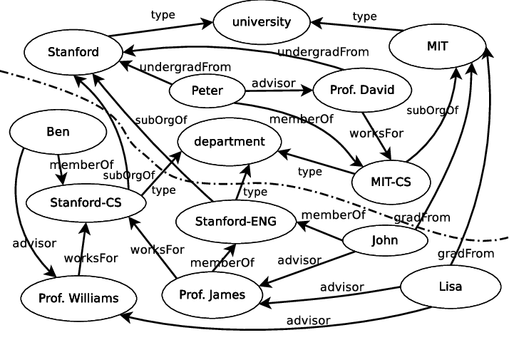
RDF Graph

Slide 23
OWL (Web Ontology Language)
OWL (Web Ontology Language) is a formal, logic-based language designed by the World Wide Web Consortium (W3C) to represent rich, complex knowledge about things, groups of things, and their interrelationships on the Semantic Web
It allows us to represent:
  Class relationships
  Property characteristics
  Restrictions
  Equivalence
  Disjointness
  Cardinality
  Logical axioms

Slide 24
RDF vs OWL
RDF | OWL
Represents triples | Represents ontology axioms
Graph-based | Logic-based semantics
Subject–predicate–object | Classes, properties, restrictions
Stores statements | Supports richer inference
Ahmad enrolledIn ML | Student ⊑ ∃ enrolledIn.Course
RDF and OWL are complementary, not competing technologies.

Slide 25
SPARQL

Slide 26
What is SPARQL
SPARQL is a query language for RDF data.
PREFIX owl: <http://www.w3.org/2002/07/owl#>
PREFIX rdf: <http://www.w3.org/1999/02/22-rdf-syntax-ns#>
PREFIX rdfs: <http://www.w3.org/2000/01/rdf-schema#>
PREFIX uni: <http://www.semanticweb.org/defaultuser0/ontologies/2026/9/Test#>
SELECT ?Student
WHERE{
?Student uni:enrolledIn uni:MachineLearning .
}

Slide 27
Example 1
PREFIX owl: <http://www.w3.org/2002/07/owl#>
PREFIX rdf: <http://www.w3.org/1999/02/22-rdf-syntax-ns#>
PREFIX rdfs: <http://www.w3.org/2000/01/rdf-schema#>
PREFIX uni: <http://www.semanticweb.org/defaultuser0/ontologies/2026/9/Test#>
SELECT ?Person
WHERE {
{?Person rdf:type uni:Lecturer }
UNION
{?Person rdf:type uni:Student }
}
ORDER BY ?Person

Slide 28
Example 2
PREFIX owl: <http://www.w3.org/2002/07/owl#>
PREFIX rdf: <http://www.w3.org/1999/02/22-rdf-syntax-ns#>
PREFIX rdfs: <http://www.w3.org/2000/01/rdf-schema#>
PREFIX uni: <http://www.semanticweb.org/defaultuser0/ontologies/2026/9/Test#>
SELECT Distinct ?Lecturer ?Department
WHERE{
?Lecturer a uni:Lecturer .
OPTIONAL {?Lecturer uni:affiliate ?Department}
}
ORDER BY ?Lecturer

Slide 29
Assignment
Create new schema containing at least:
5 Entities
5 Object Properties
5 Data Properties
15 Individuals
Then perform at least 2 simple queries and 3 complex queries

